Slide 1
Recreating an Apache Maven bug w/ JQF Testing
By Jordan Sam and Benson Wan

Slide 2
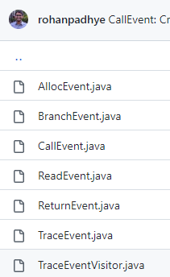
What is JQF?
Platform to conduct coverage-guided fuzz testing
Open source
Coarse grained system
Instrument software bytecode
Assign a random number to every instruction to java back code
Utilizes a structured input generator
Junit-quickcheck
Zest algorithm
Notes:
JORDAN
In Java, JQF is a platform to conduct coverage-guided fuzz testing.
Instrument means to assign a random number to every instruction to java back code
What goes on under the hood: We label each location of java instructions at the back code level. In order to reduce the complexity, JQF utilizes a coarse grained system. Does anyone know what that means? This basically means that the system consists of fewer but larger components to make the testing tool run. In other words, coarse grained are made up of some of the more fine-grained components and services since fine-grained are the smaller components.
For example, a BranchEvent is generated when a test program executes a conditional branch, a CallEvent accompanies a method invocation, and an AllocEvent signals the creation of a new object or array on the heap.

Slide 3
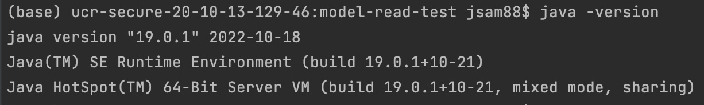
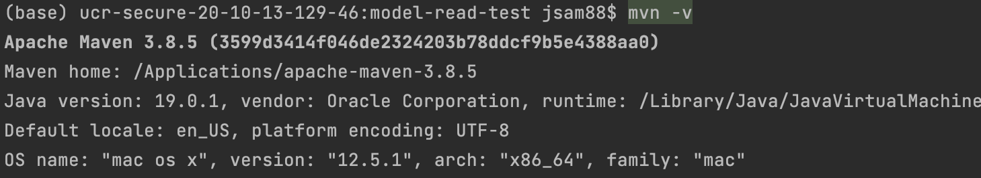
How to Install JQF + Zest
Java 9+
Apache Maven
Build JQF
Bash
Launch fuzzing scripts
2 different ways:
Cloning the JQF github repository
Utilizing the maven plugin
Do not need JQF installed locally
Does not need to run bash scripts
Notes:
BENSON:
You can use JQF locally or with the maven plugin
When running the software testing tool, depending on which you choose there are different formats that are used to make it run.

Slide 4
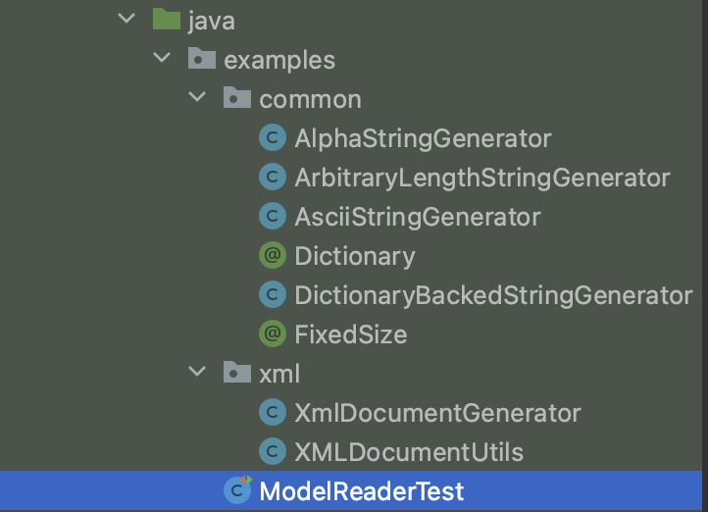
How to Run JQF + Zest
Some example inputs for the JQF local version:
mvn package
javac -cp .:$(scripts/classpath.sh) .java classes
bin/jqf-zest -c .:$(scripts/classpath.sh) x y
Some example inputs for the JQF maven plugin:
mvn test-compile
mvn jqf:fuzz -Dclass=examples.ModelReaderTest -Dmethod=testWithString -Dtime=1m
Notes:
BENSON:
Where x is the java class and y is the test in the class
Note: the plugin should be able to run both ways. ACCORDING TO TA. Not sure though

Slide 5
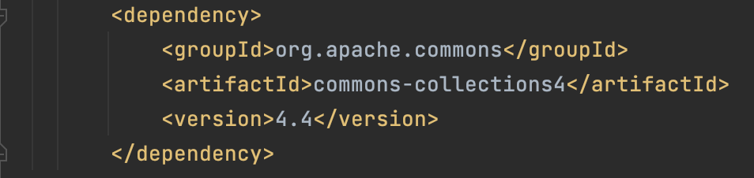
Software we are testing and its Inputs
Basic structure:
Pom.xml
Application code
Test driver
Input generator
Our software under test setup:
Pom.xml
XMLDocumentUtils.java = Application code
ModelReaderTest.java = Test driver
Xml and commons folder = Input generator
Notes:
BENSON:
Since we are recreating a bug from the JQF examples github repo, we decided to utilize the Maven plugin.
Look through zip file
These are from the JQF ZEST tutorial.
pom.xml
Application code
Test driver
Input generator
Explain what apache commons is
Apache Maven pom.xml file parser

Slide 6
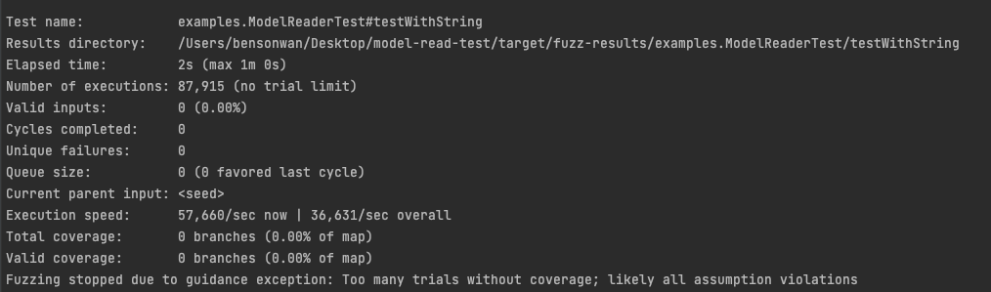
What Does This Status Screen Mean?
Notes:
JORDAN

Slide 7
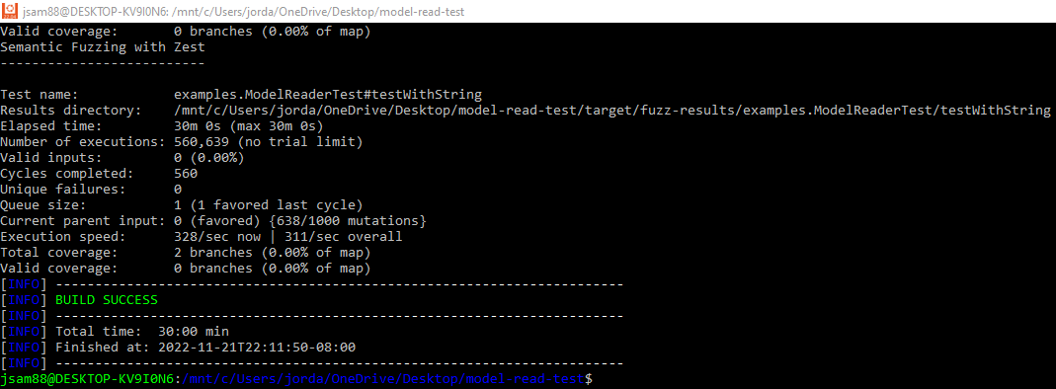
Our Findings (ModelReaderTest testWithString 30min)
Notes:
JORDAN

Slide 8
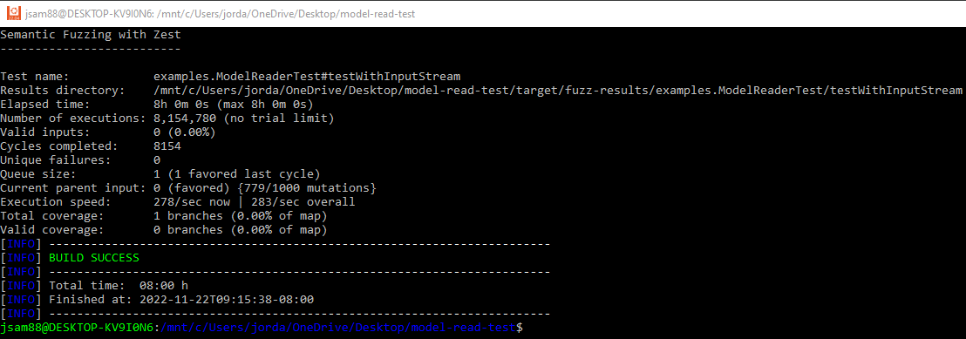
Our Findings (ModelReaderTest testWithInputStream 8hrs)
Notes:
JORDAN:
Relate the preliminary test with the bug test. What are we discovering now compared to what we are going to potentially find later in the apache maven test.
Start with better generator (talk about diff generators for the bug program we wanna test)

Slide 9
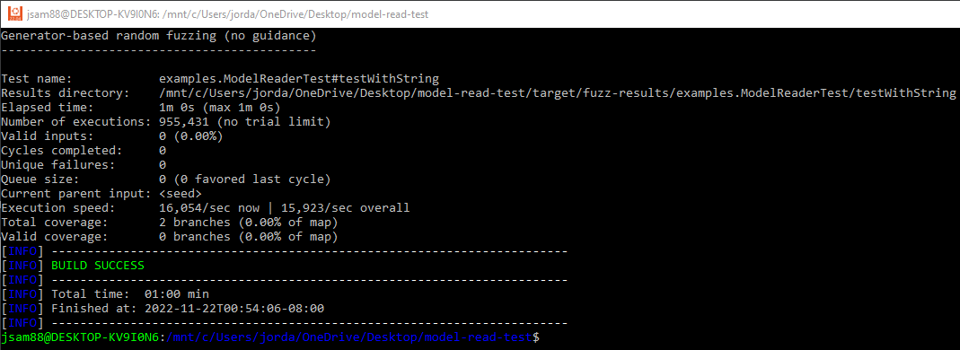
Comparison to Blind Fuzzing
-Dblind
How do we improve coverage or how to generate better inputs?
Notes:
JORDAN:

Slide 10
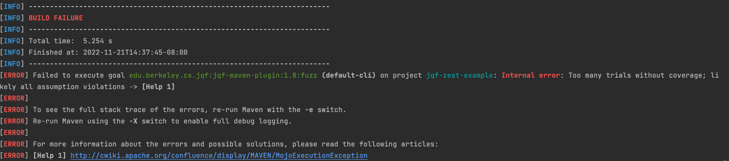
Difficulties/Challenges:
Initial setup on macOS
Multiple errors because some dependencies were blocked?
Notes:
JORDAN: - Cant edit file where theres an catch and throw block because its read only.

Slide 11
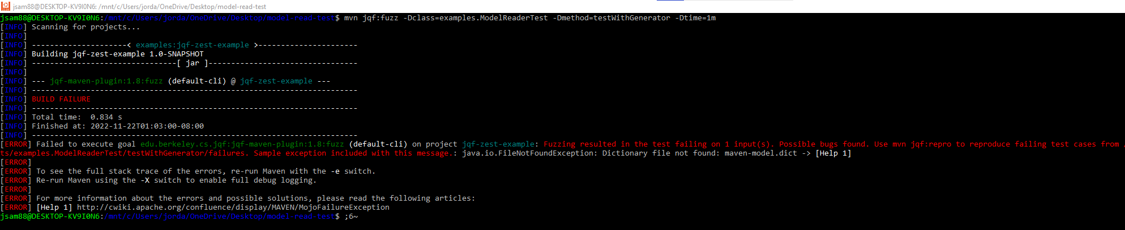
Difficulties/Challenges Continued:
Writing test generators similar to handwritten unit tests.
Thankfully our generators are written in the JQF examples
Once we get it working:
Pay off is worth it
save time by automating
Notes:
BOTH:
Rewards:
Rewards:
Pay off is high
AFL + JQF = meaningful/usable inputs
Automated
Pay off is high because we are utilizing a valid input, mutating it, and maintaining a syntactically valid input domain.
Works well with tools such as AFL that test syntax

Slide 12
Thank you for listening!
Questions?

